Slide 1
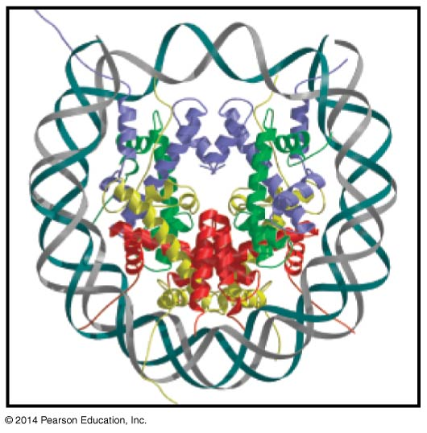
Genome structure, chromatin and the nucleosome
BT 451
Chapter 8

Slide 2
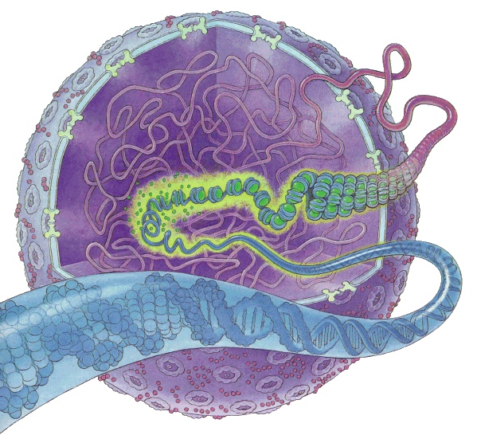
Why DNA is compacted into chromosomes?
To fit DNA inside the cell
  3X10⁹ bp X0.3 nm ≈ 1m in haploid cell
To protect DNA from damage.
To transmit DNA efficiently to daughter cells.
To Facilitate gene expression
To ensure that recombination takes place between homologous chromosomes only
Compaction depresses all DNA transaction

Slide 3
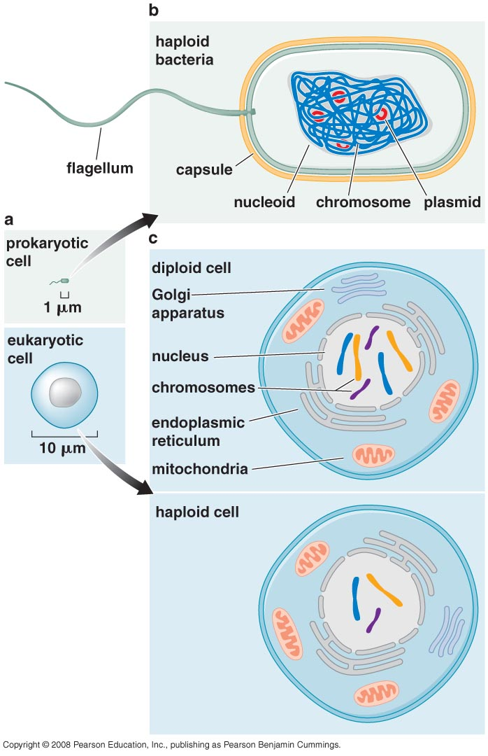
Comparison of typical Prokaryotic and eukaryotic cells

Slide 4
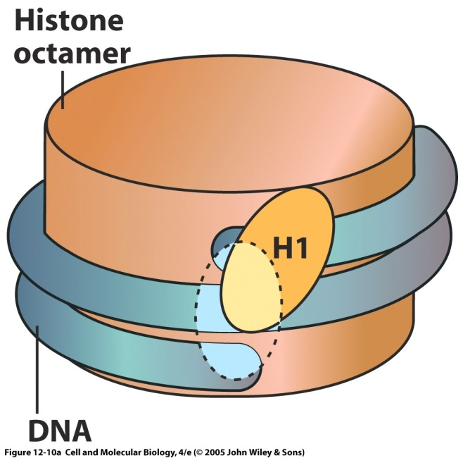
Definitions
Chromosome: DNA & it’s associated proteins
Chromatin: a region of DNA with it’s associated proteins
Proteins are responsible for compacting the DNA
Two types of proteins:
  Histone
  Non-histone

Slide 5
Chromosome Sequence & Diversity
Traditional view
Prokaryotes have a single circular chr and eukaryotes have multiple linear chrs
variable chr number
Circular chrs require topoisomerases to separate the daughter molecules after replication
Liner ends of chrs have to be protected

Slide 6
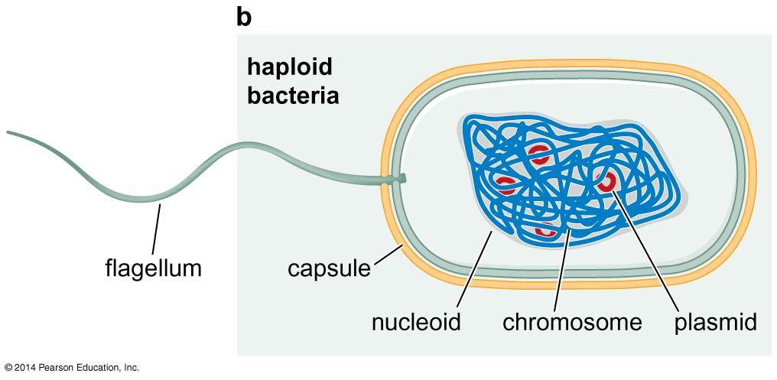
Prokaryotic cells

Slide 7
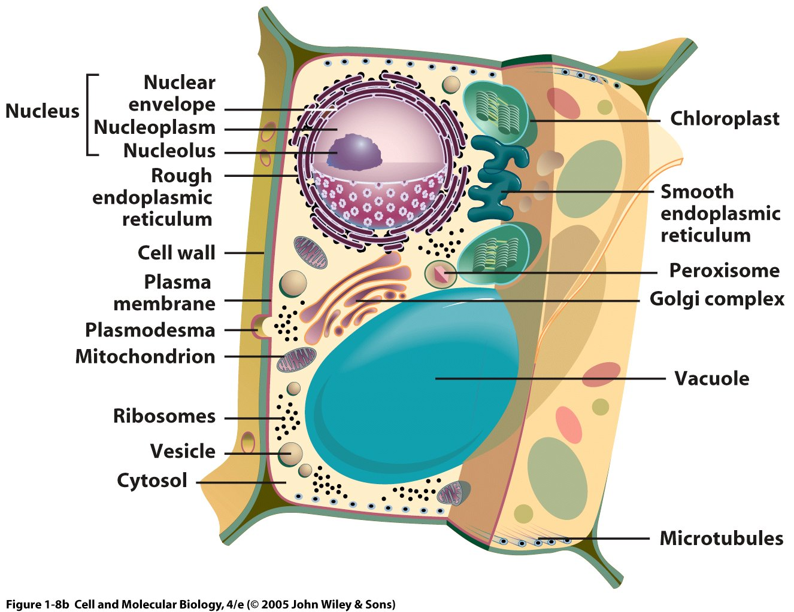
Eukaryotic cells

Slide 8
Chromosome number
Prokaryotes → one copy as Nucleoid
Sometimes have plasmids
Majority of eukaryotes → diploid (two copies of each chr called homologs)
Haploid (single copy)
Polyploid: > 2 copies e.g. megakaryocytes (28 copies), can maintain very high levels of metabolism necessary to produce thousands of platelets that lack chromosomes.

Slide 9
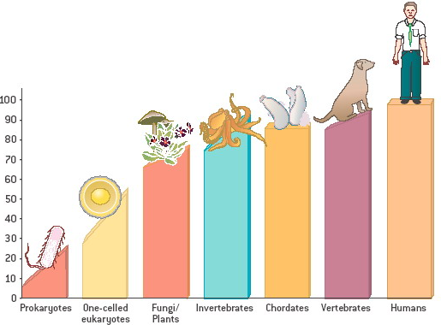
Genome size is related to the organism complexity
Genome size is Related to complexity of the organism when comparing different groups
Genome size α complexity among major groups

Slide 10
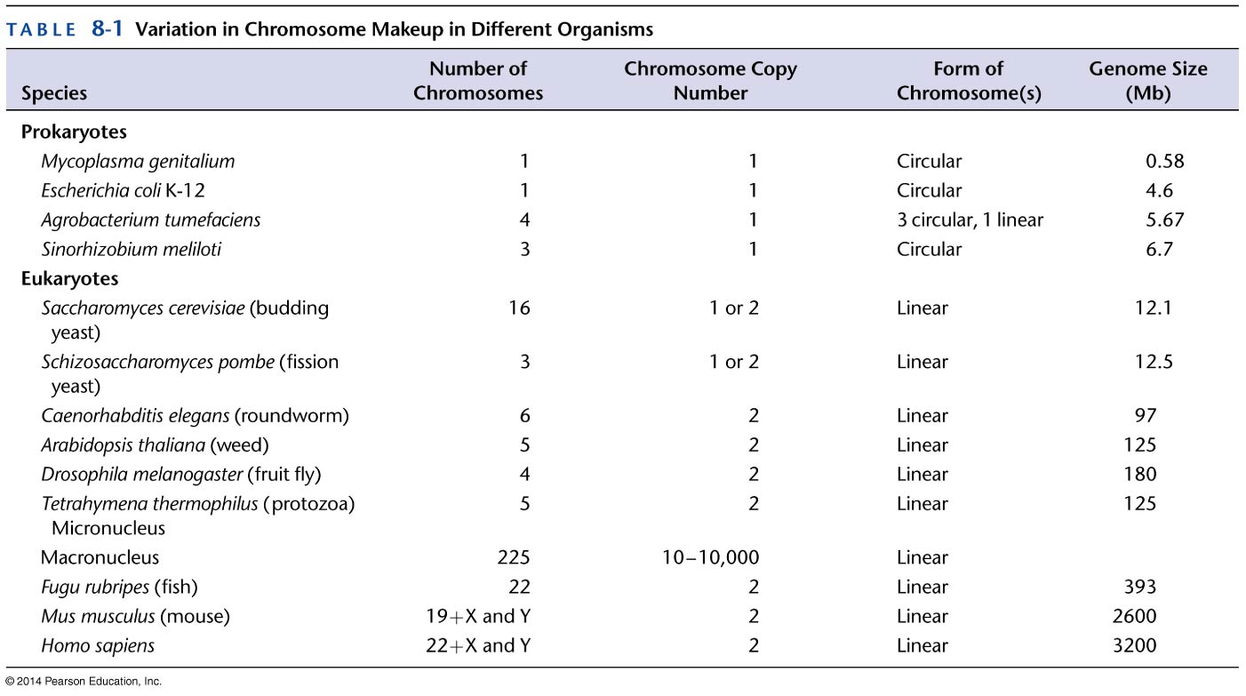

Slide 11
General Rules
Organism complexity α Gene size
Organism complexity 1/α Gene density
Prokaryotes → < 10 Mb
Single-celled eukaryotes → < 50 Mb
Multicellular eukaryotes → > 100,000 Mb
Number of genes rather than genome size is more closely related to organism complexity

Slide 12
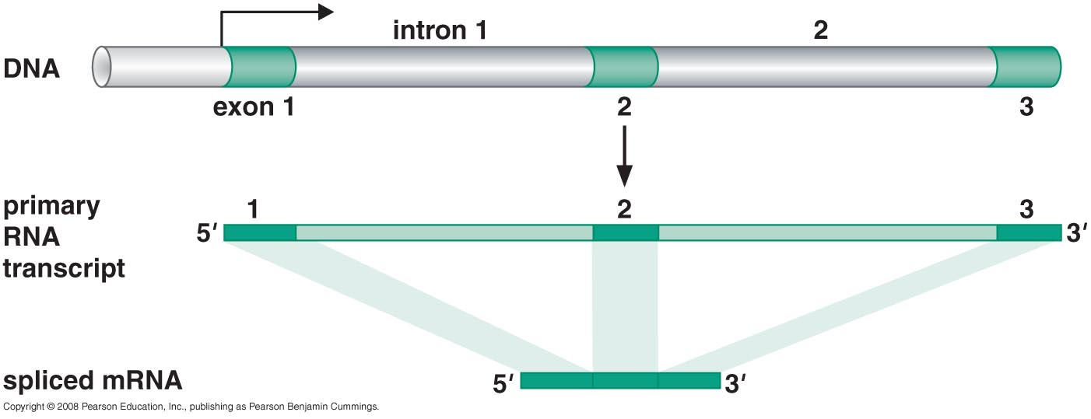
Schematic of RNA splicing

Slide 13
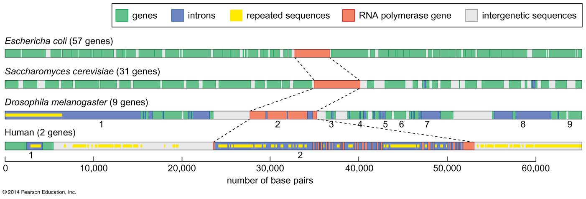
Comparison of gene density among different organisms
Great majority of E.coli encodes proteins or structural RNAs
non-coding sequences → regulate gene transcription
More Complexed organisms have decreased gene density measured as number of genes per megabase of genomic DNA
Bacterial density → 1000 gene/ Mb
S. Cerevisiae → 500 genes / Mb
Human → 6 genes / Mb

Slide 14
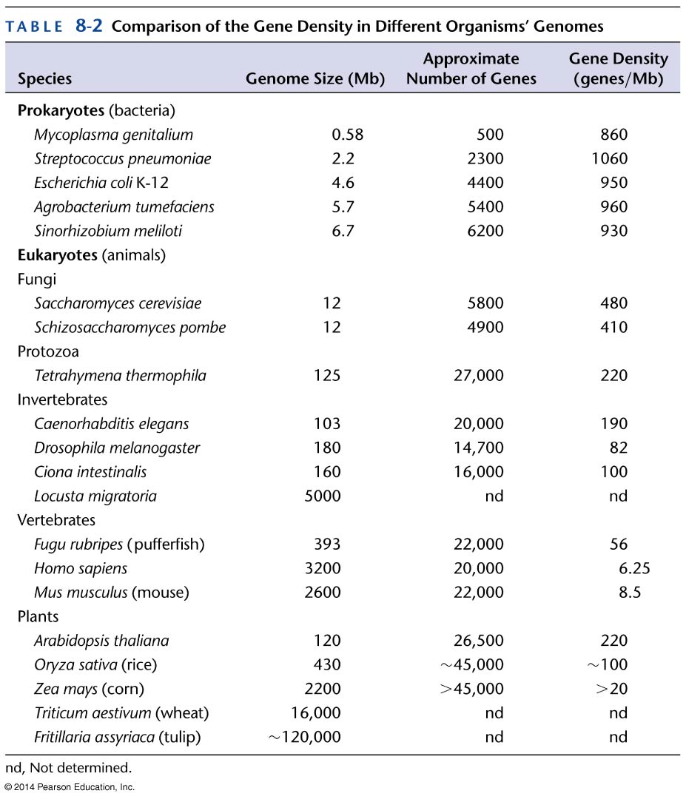

Slide 15
Genes make up small proportion of eukaryotic DNA
Decreased gene density due to increase in gene size and increase in DNA between genes called intergenic sequences
Introns: interspersed non-coding regions that can be removed by splicing
Average transcribed region of a human gene is ~ 27 kb whereas the average human protein-coding gene of a human gene is 1.3 kb. Only ~ 5% of the average human gene codes for a protein.
Intergenic DNA (~ 60% in human) : the portion of genome that does not encode proteins or RNAs
Unique and repeated
Unique : (1/4 and increased by the increase in regulatory sequences, also can include nonfunctional mutant genes, gene fragments (arise from simple random mutagenesis or mistakes in DNA recombination) and pseudogenes (arise from the action of Reverse transcriptase as a side effect of viral infection)
miRNA: unique interegenic sequences that act to regulate the expression of other genes by altering the stability of the mRNA or its ability to be translated

Slide 16
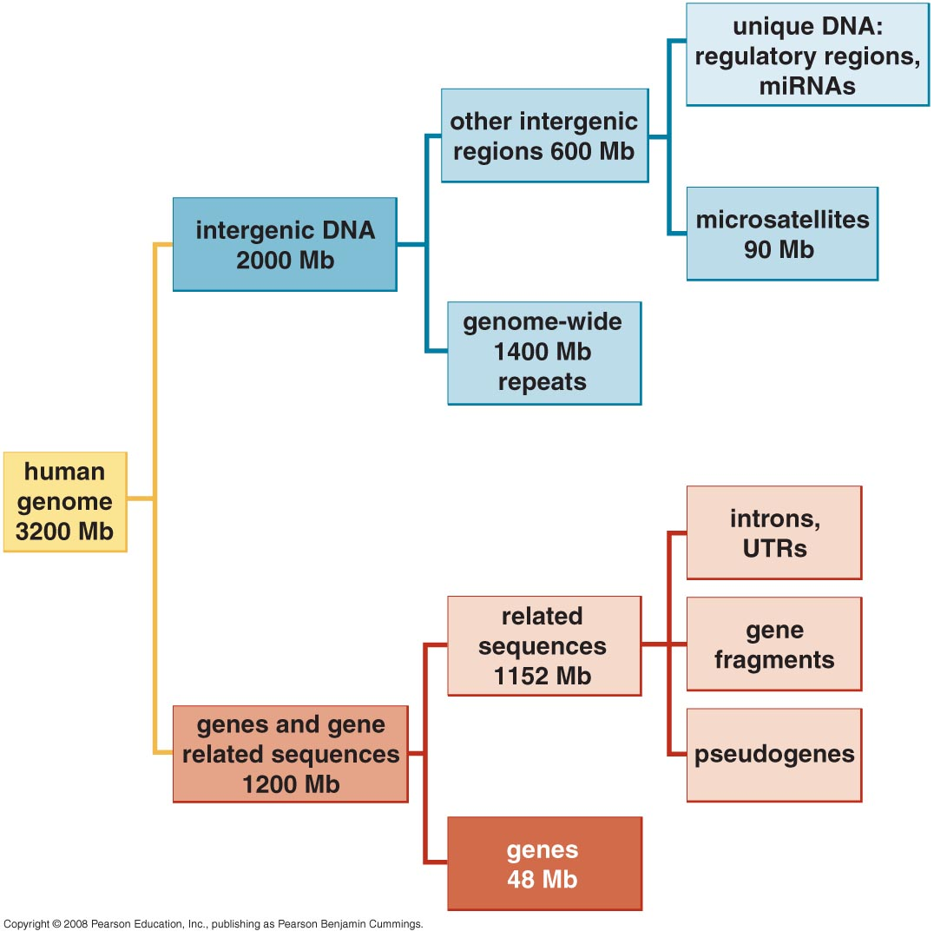
Organization and content of human genome

Slide 17
Majority of human intergenic sequences are Repetitive DNA
Microsatellite DNA: short (<13 bp) tandemly repeated sequences e.g dinucleotide repeats CACACACACACACA. Arise from difficulties in accurately duplicating the DNA and represent ~ 3% of the human genome
Genome wide repeats: larger > 100 bp even > 1 kb found either as a single copies dispersed throughout the genome or as closely spaced clusters.
Numerous classes of them but their common feature is that all are forms of transposable elements

Slide 18
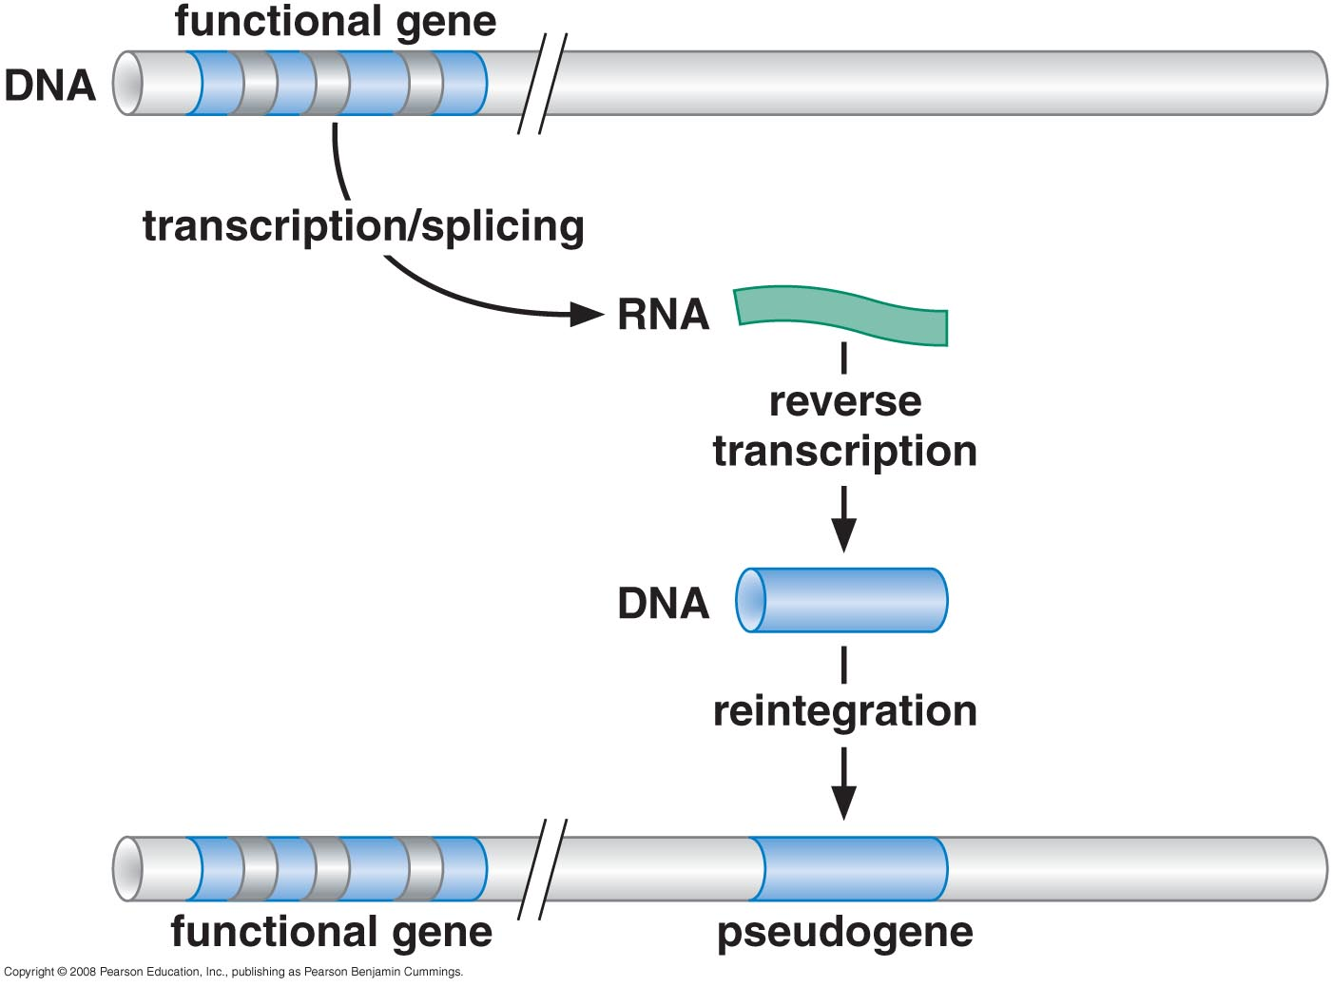
Processed pseudogenes arise from integration of reverse-transcribed RNAs

Slide 19
Transposable elements
sequences that can move from one place in the genome to another
During transposition, the element moves to a new position in the genome often leaving a copy behind
Movement of TE in human is a rare event in human cells
Nevertheless, over long period of time these elements have been successful in propagating themselves that they now comprise 45% of the human genome
Many feature of intergenic sequences are the same in other organisms

Slide 20
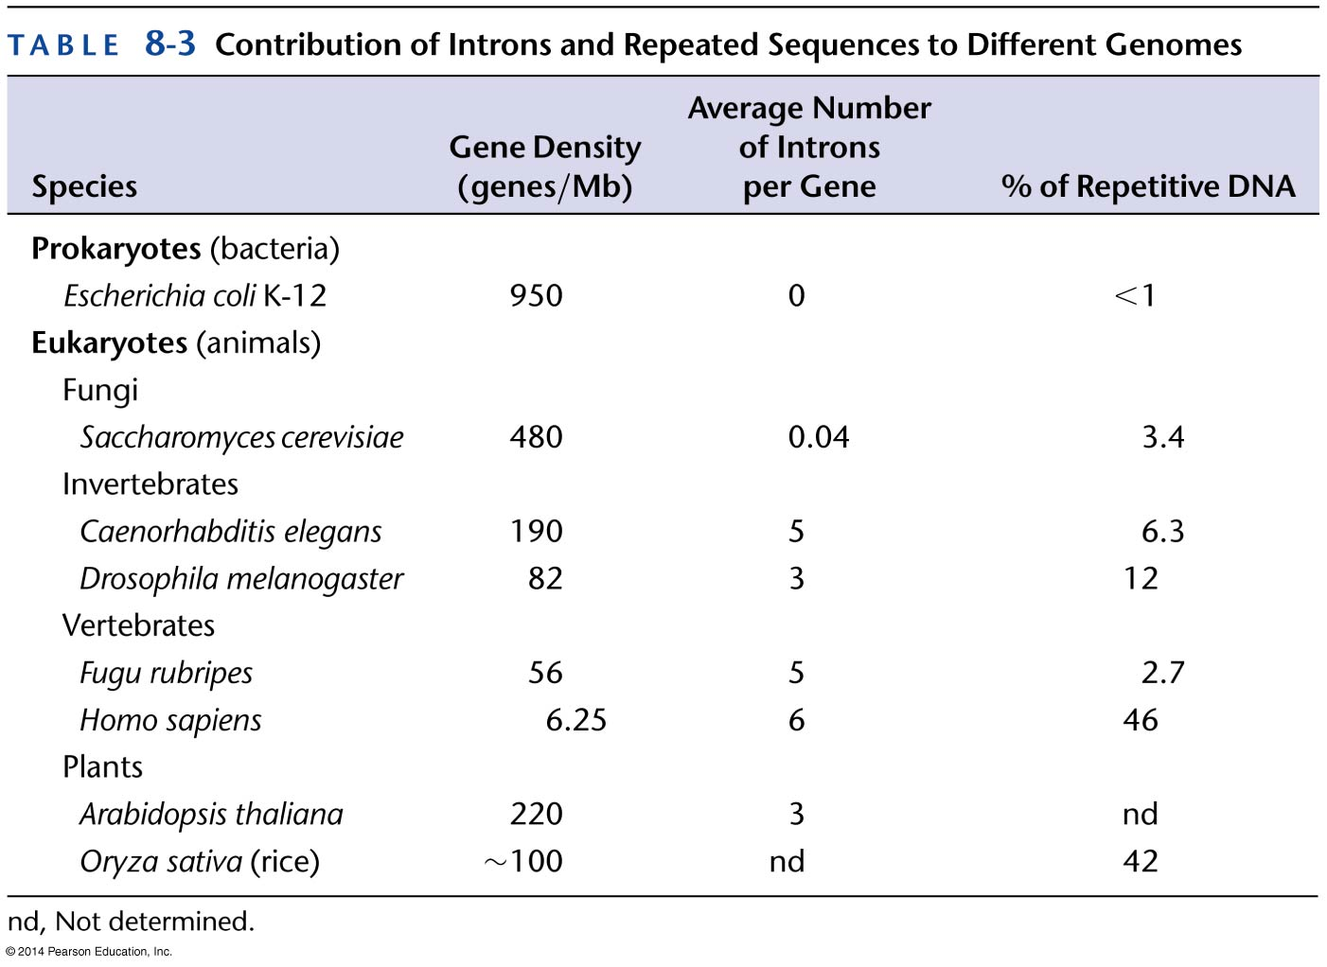

Slide 21
Chromosome duplication and segregation

Slide 22
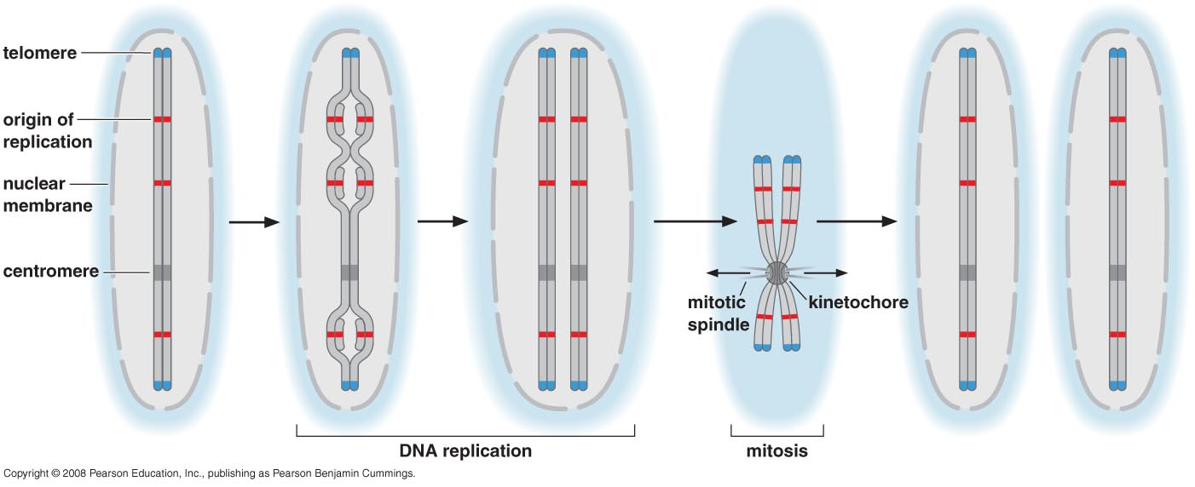
DNA sequences holding specific functions
Important elements that are not genes and not involved in gene regulation
Origin of replication, centromeres and telomeres

Slide 23
Origin of replication
sites at which DNA replication machinery assembles to initiate replication.
Found typically 30-40 kb apart
Found in noncoding regions
Single ori in prok vs multiple ori in eukaryotes

Slide 24
Centromere
Are required for the correct segregation of the chrs after replication
Direct the formation of an elaborate protein complex called kinetochore
The kinetochore interacts with the centromere DNA and with protein filaments called Microtubules that pull the sister chromatids away from each other and into the two daughter cells
Each chr has one centromere (critical)

Slide 25
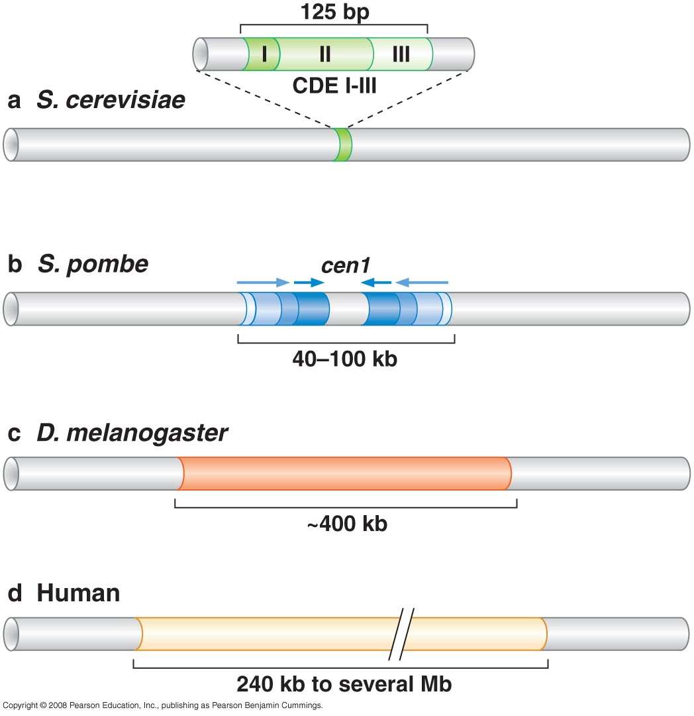
Centromere size and composition vary dramatically among different organisms

Slide 26
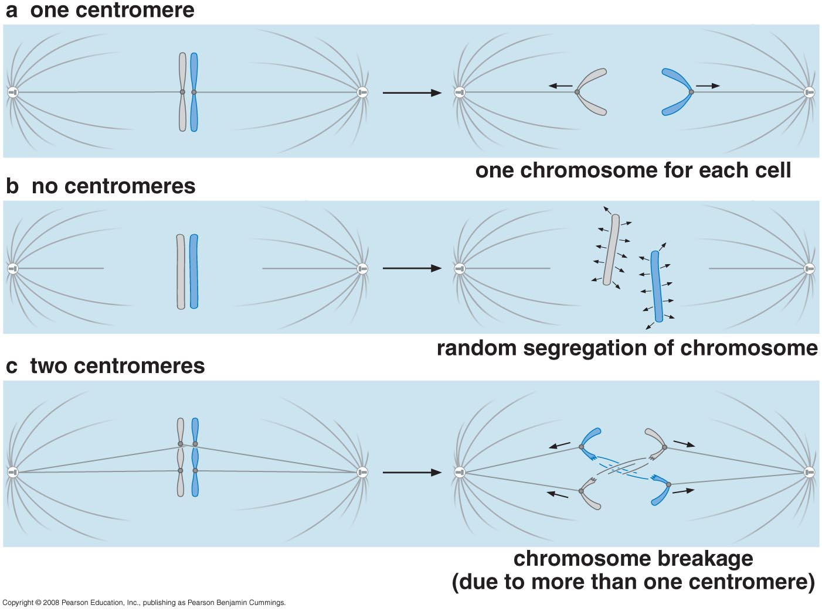
More or less than one centromere leads to
chromosome loss or breakage

Slide 27
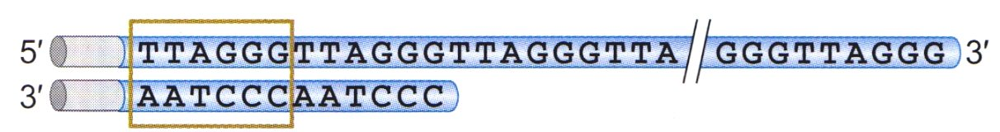
Telomeres
Repetitive DNA sequence (TG-rich in human)
A considerable portion is single stranded
Bounded to proteins which:
  distinguish the natural ends from sites of breakage. Usually, DNA ends are site of frequent recombination and degradation. These proteins form a structure that is resistant to both of these events
  Telomeres act s specialized origin of replication that allows the cell to replicate the ends of the chrs
  Telomerase facilitate end replication through the recruitment of an unusual DNA polymerase called telomerase

Slide 28
Chromosome duplication & segregation

Slide 29
The Cell Cycle
An ordered sequence of events that occurs from the time when a cell is first formed until it divides into two new cells.
Most of the cell cycle is spent in interphase.
Cells that stopped dividing (neurons) are in G₀ phase
Following interphase, the mitotic stage of cell division occurs.

Slide 30
Types of Cell division
Mitosis
Meiosis

Slide 31
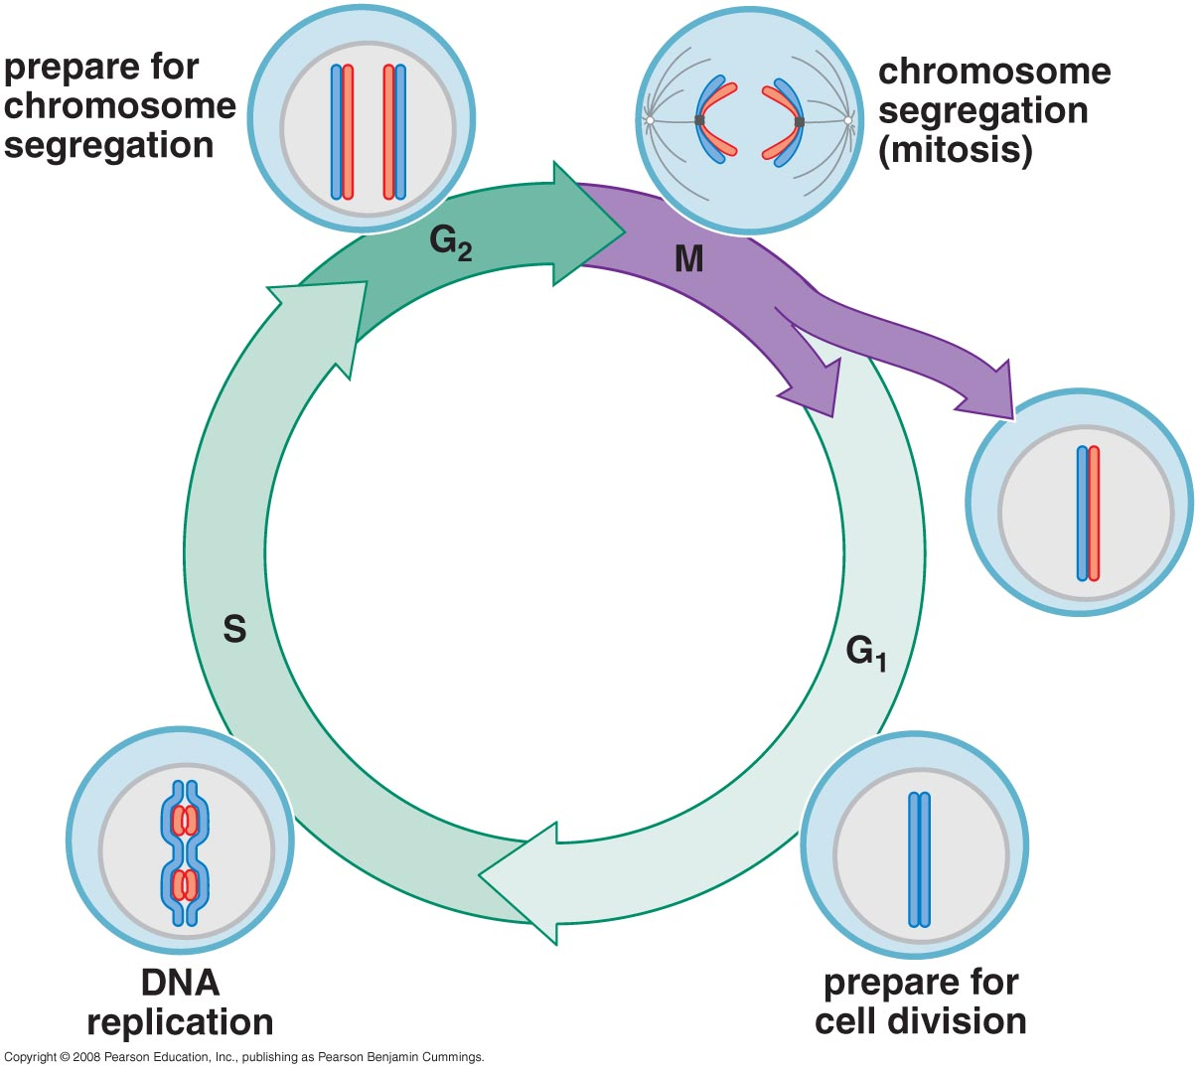
Eukaryotic mitotic cell cycle
Notes:
Cells go through a cycle that consists of four stages: G1, S, G2, and M. During G1, growth occurs as organelles double. During the S stage, DNA replication occurs as chromosomes duplicate. During the G2 stage, growth occurs as the cell prepares to divide. During the M stage, mitosis and cytokinesis occur.

Slide 32
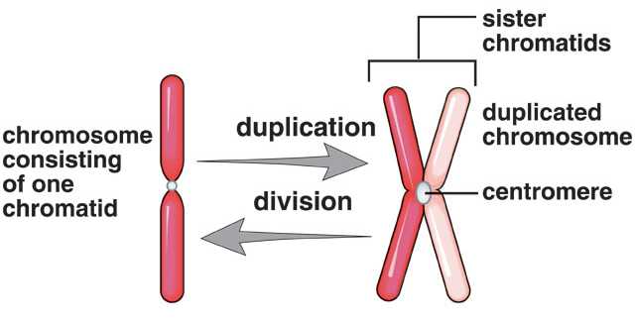

Slide 33
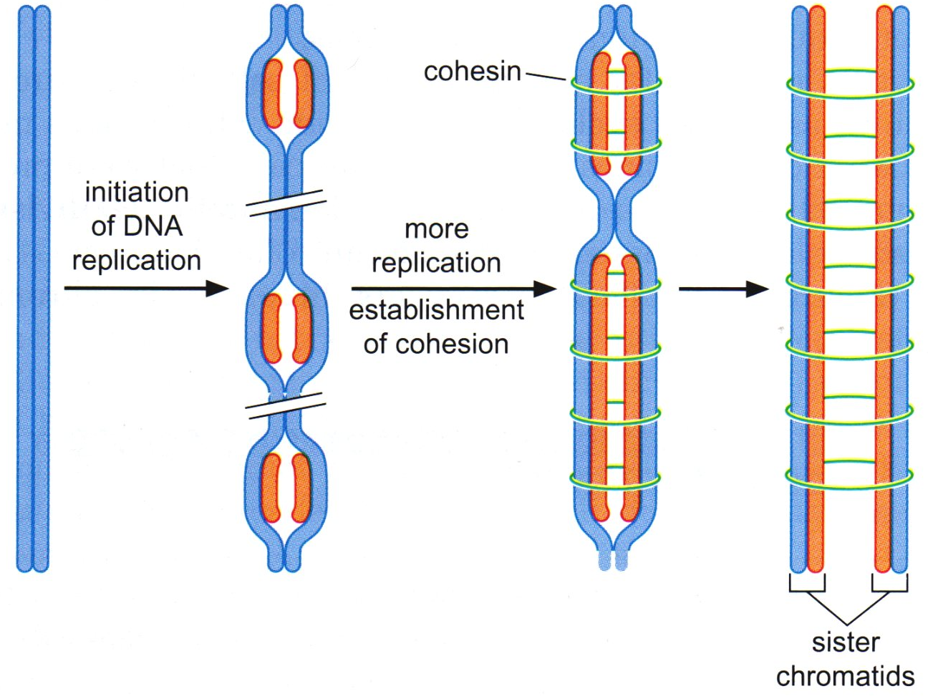
Events of S phase
sister chromatid cohesion is mediated through cohesin
Sister chromatids are genetically identical

Slide 34
Each pair of sister chromatids is bound to mitotic spindle (microtubules attached to microtubules organizing centers (called centrosomes in animal cells and spindle pole bodies in yeast and fungi))
Attachment of the chromatids to the microtubules is mediated by the kinetochore assembled at each centromere
Cohesion between the chromatids is dissolved by proteolysis of cohesin.
After cohesin is dissolved , sister chromatid separation occur.

Slide 35
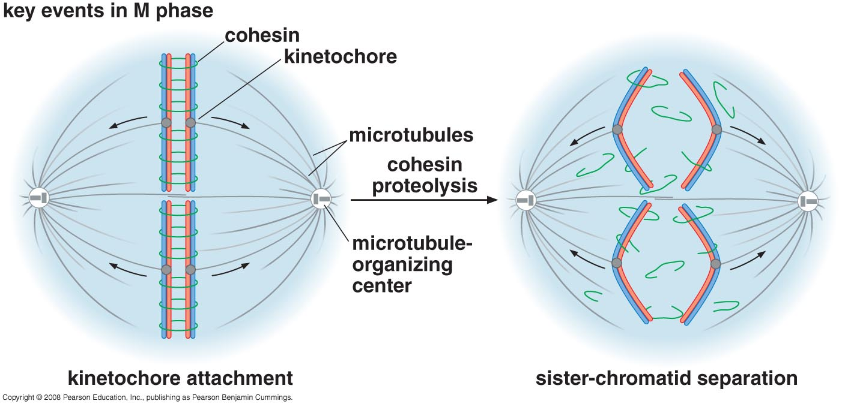
Events of M phase

Slide 36
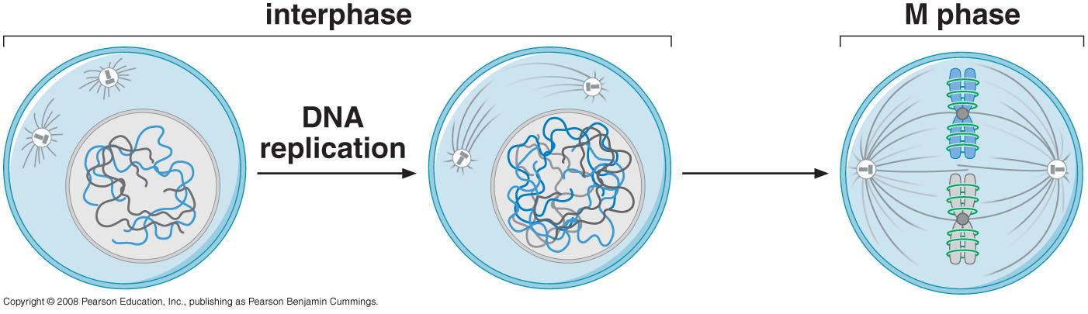
Changes in chromatin structure

Slide 37
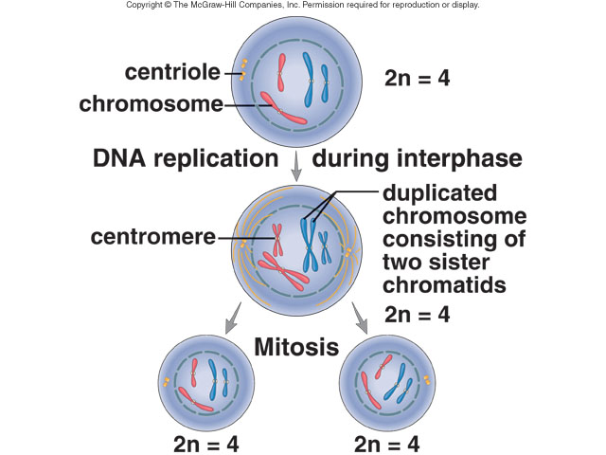
Notes:
Following DNA replication during interphase, each chromosome in the parental nucleus is duplicated and consists of two sister chromatids. During mitosis, the centromeres divide and the sister chromatids separate, becoming daughter chromosomes that move into the daughter nuclei. Therefore, daughter cells have the same number and kinds of chromosomes as the parental cell. In this figure, the blue chromosomes were inherited from one parent, and the red chromosomes were inherited from the other parent.

Slide 38
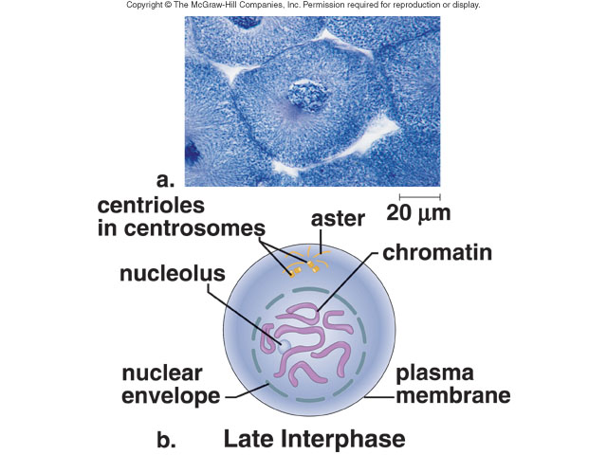
Chromosome structure changes as eukaryotic cells divide
Late Interphase
The chrs are in their most compact
form as cells segregate their chrs
Compactness results from
Chr condensation
Notes:
During late interphase, before the start of mitosis, duplicated chromatin is condensing into chromosomes, and centrosomes have duplicated in preparation for mitosis.

Slide 39
sister-chromatid cohesion and chromosome condensation are mediated by SMS proteins
The structural maintenance of chrs (SMC) proteins are extended proteins that form defined pairs by interacting through lengthy coiled-coiled domains.
Together with non-SMC protein they form multiprotein complexes that act to link two DNA helices together.
The structure of cohesin is thought to be a large ring composed of two SMC proteins and two non-SMC proteins
The chr condensation also requires a related SMC-containing complex called condensin

Slide 40
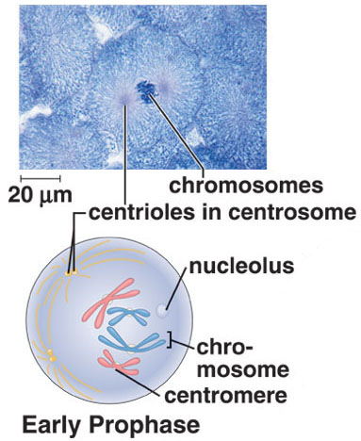
1- Early Prophase
Chromosomes condensation via SMC called condensin
Notes:
During early prophase, mitosis has begun. Duplicated chromosomes are now visible. Each chromosome is duplicated and composed of sister chromatids held together at a centromere. Centrosomes begin moving apart, the nuclear envelope is fragmenting, and the nucleolus will disappear.

Slide 41
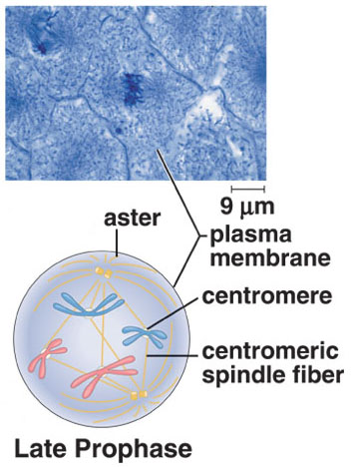
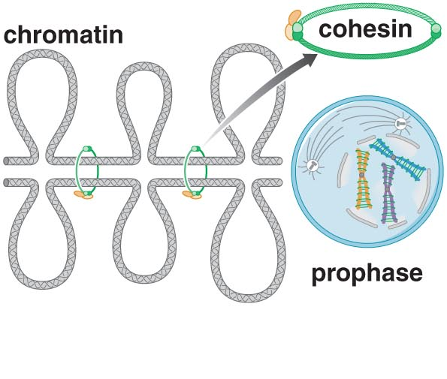
1- Late Prophase
Binding of each chromatid to a mitotic spindle through kinetochore
Notes:
During late prophase, the spindle is forming and spindle fibers appear between the separating chromosomes. Centromeres attach to spindle fibers called centromeric (or kinteochore) fibers. The chromosomes have no particular orientation as yet.

Slide 42
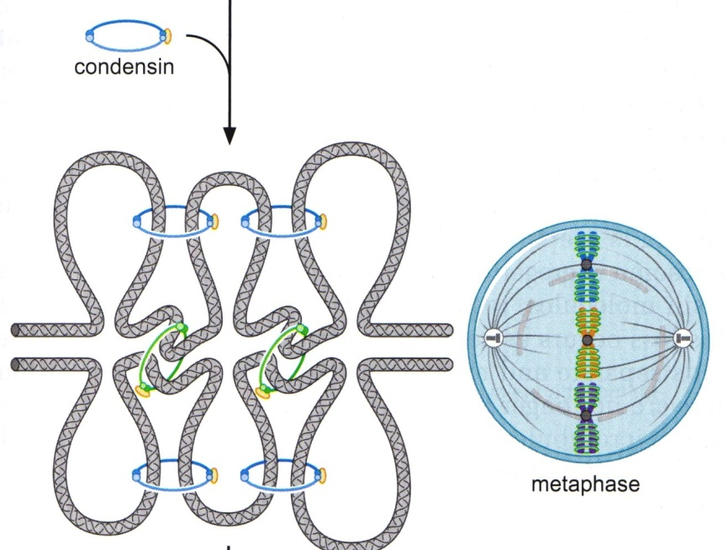
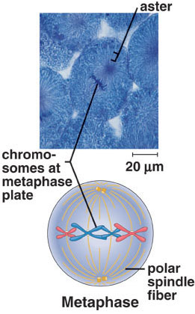
2- Metaphase
Chromosome aligned along the metaphase plate
Bivalent attachment
Chr segregation starts only after all sister-chromatid pairs have achieved bivalent attachment
Notes:
By the time of metaphase, the fully formed spindle consists of poles, asters, and fibers. The metaphase plate is a plane perpendicular to the axis of the spindle and equidistant from the poles. The chromosomes attached to the centromeric spindle fibers line up at the metaphase plate during metaphase. Polar spindle fibers reach beyond the metaphase plate and overlap.

Slide 43
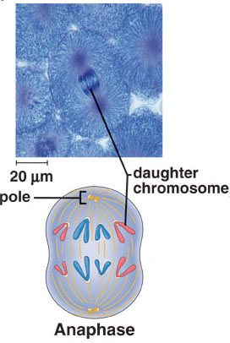

3- Anaphase
Dissolving of cohesin
Sister chromatid separate
Notes:
During anaphase, daughter chromosomes (each consisting of one chromatid) are moving toward the poles of the spindle. The daughter chromosomes have a centromere and a single chromatid. The movement of the daughter chromosomes occurs because the centromeric spindle fibers disassemble at the region of the centromere, pulling the daughter chromosomes toward the poles, and because the polar spindle fibers push the poles apart as they lengthen and slide past one another.

Slide 44
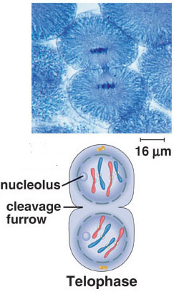
4- Telophase
Nuclear envelope starts to form
Notes:
During telophase, the spindle disappears, and the nuclear envelopes begin to reform around daughter nuclei. Each 2n daughter nucleus contains the same numbers and kinds of chromosomes as the original 2n parental cell.
Chromosomes become diffuse chromatin again, and a nucleolus appears in each daughter nucleus. At this point, cytokinesis is also nearly complete.

Slide 45
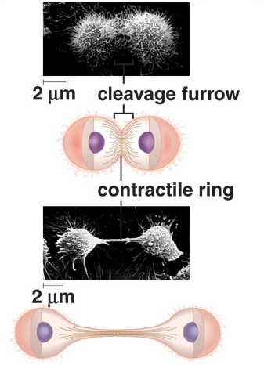
Cytokinesis
Division of the cytoplasm
Notes:
A single cell becomes two cells by a furrowing process. A contractile ring composed of actin filaments gradually gets smaller, and the cleavage furrow pinches the cell into two cells.

Slide 46
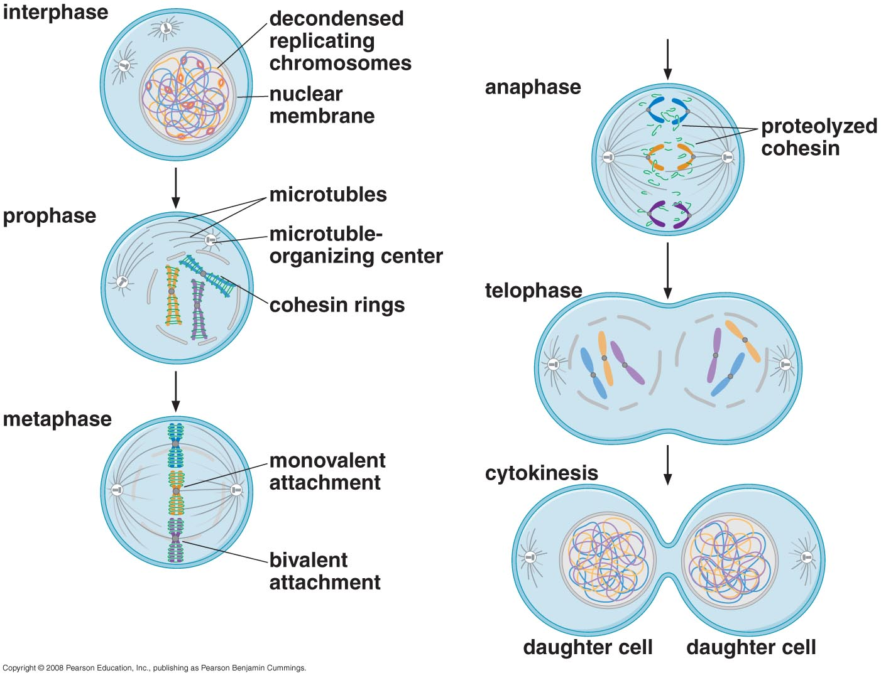
Mitosis in detail

Slide 47
Gap Phase (check point)
G1
G2

Slide 48
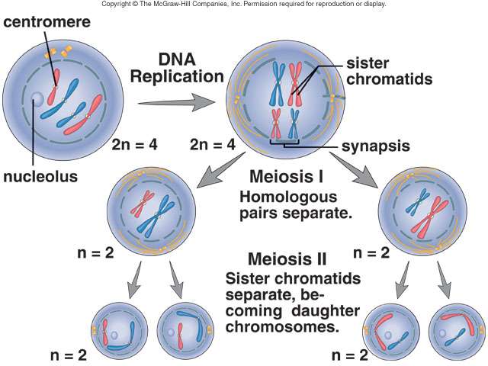
Meiosis
Notes:
Following DNA replication, each chromosome is duplicated. During meiosis I, the homologous chromosomes pair during synapsis and then separate. During meiosis II, the centromeres divide and the sister chromatids separate, becoming daughter chromosomes that move into the daughter nuclei.

Slide 49
Meiosis I separates homologous pairs of chromosomes.
Daughter cells are haploid, but chromosomes are still in duplicated condition (consists of two chromatids).
Meiosis II separates sister chromatids.
The completely haploid daughter cells mature into gametes.

Slide 50
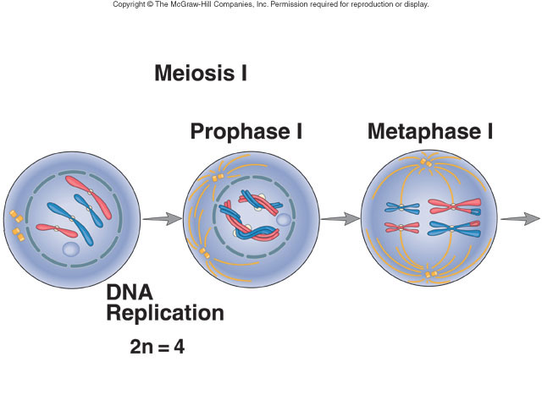
Meiosis I
Homologous chromosomes aligned at metaphase plate
Homologous recombination
Monovalent attachment (attachment of one sister chromatid)
Notes:
During prophase I, the spindle appears while the nuclear envelope fragments and the nucleolus disappears. Because DNA replicated during interphase prior to meiosis I, the homologous chromosomes each have two sister chromatids. During synapsis, crossing-over can occur. If so, the sister chromatids of a duplicated chromosome are no longer identical.
During metaphase I, homologous pairs are aligned at the metaphase plate.

Slide 51
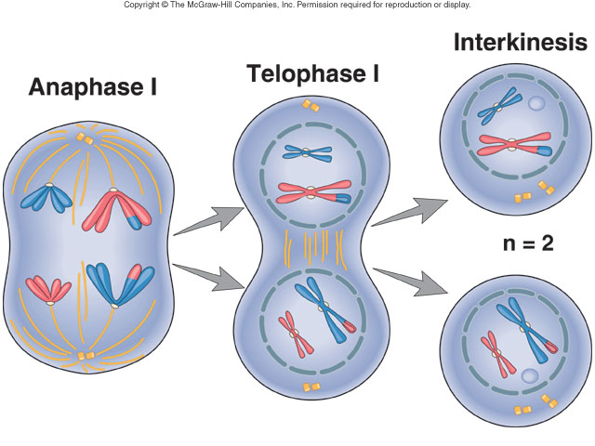
Meiosis I
Notes:
During anaphase I, homologous chromosomes separate and move to opposite poles of the spindle. Each chromosome still consists of two chromatids.
At telophase I, nuclear envelopes may reform and nucleoli may reappear. Cytokinesis may or may not occur at this point.
Interkinesis is a stage between the two meiotic divisions when chromosomes still consist of two chromatids.

Slide 52
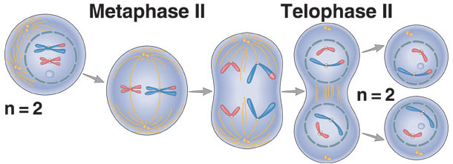
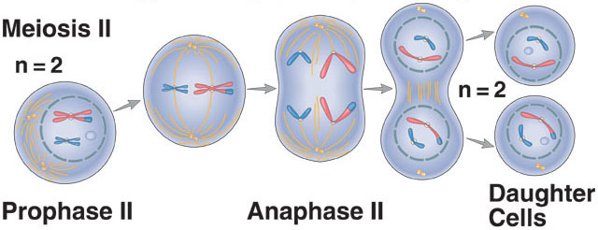
Meiosis II (similar to mitosis)
Notes:
At the beginning of prophase II, a spindle appears while the nuclear envelope disassembles and the nucleolus disappears.
During anaphase II, sister chromatids separate, becoming daughter chromosomes that move into the daughter nuclei.

Slide 53
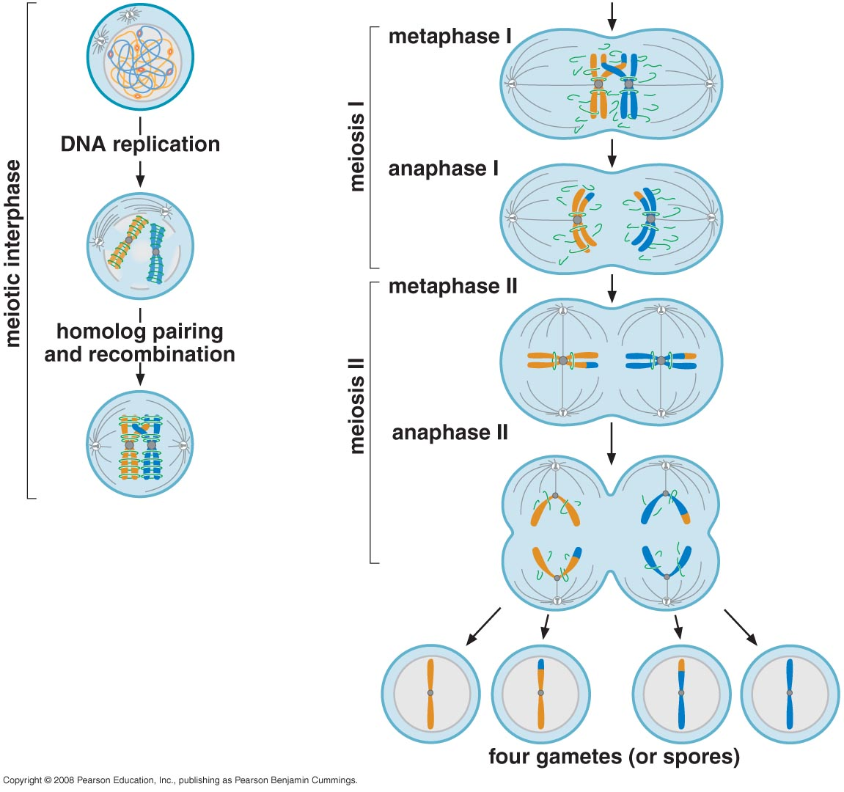

Slide 54
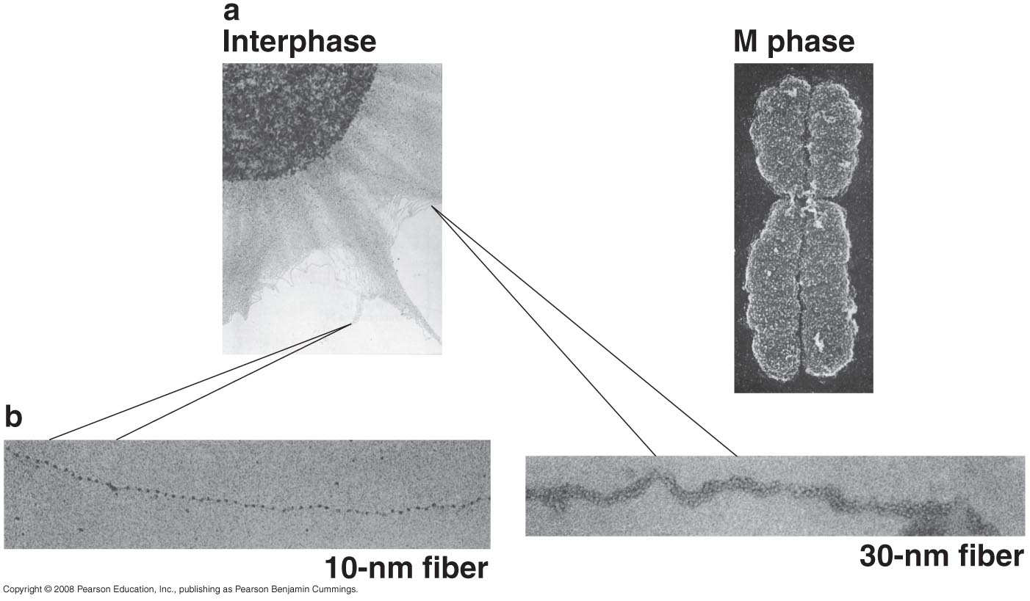
Forms of chromatin structure seen in the electron microscope

Slide 55
The Nucleosome

Slide 56
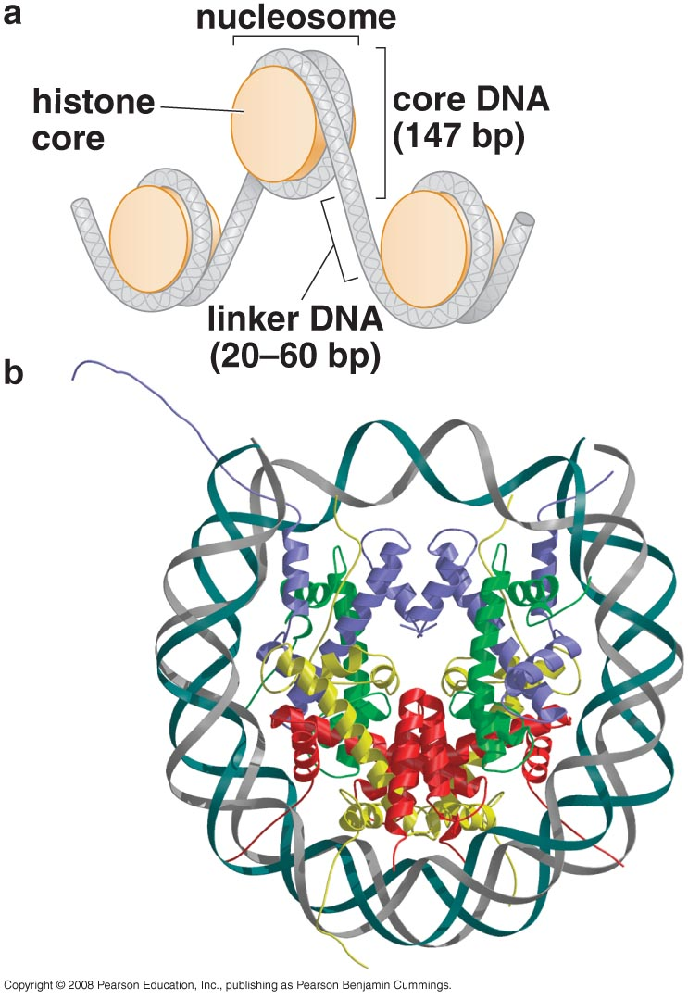
The Nucleosome
Histone octamer (core Histone)
  H2A
  H2B
  H3
  H4
Core DNA
  Wrapped around core histone (1.65x)
  Determined by using nuclease treatment
  Invariant feature of eukaryotic nucleosomes (~ 147 bp)
Linker DNA: variable length (20-60 bp) due to differences in larger structures formed by nucleosomal DNA
Beads on string
In any cell, there are stretches of DNA that are not packaged into nucleosomes

Slide 57
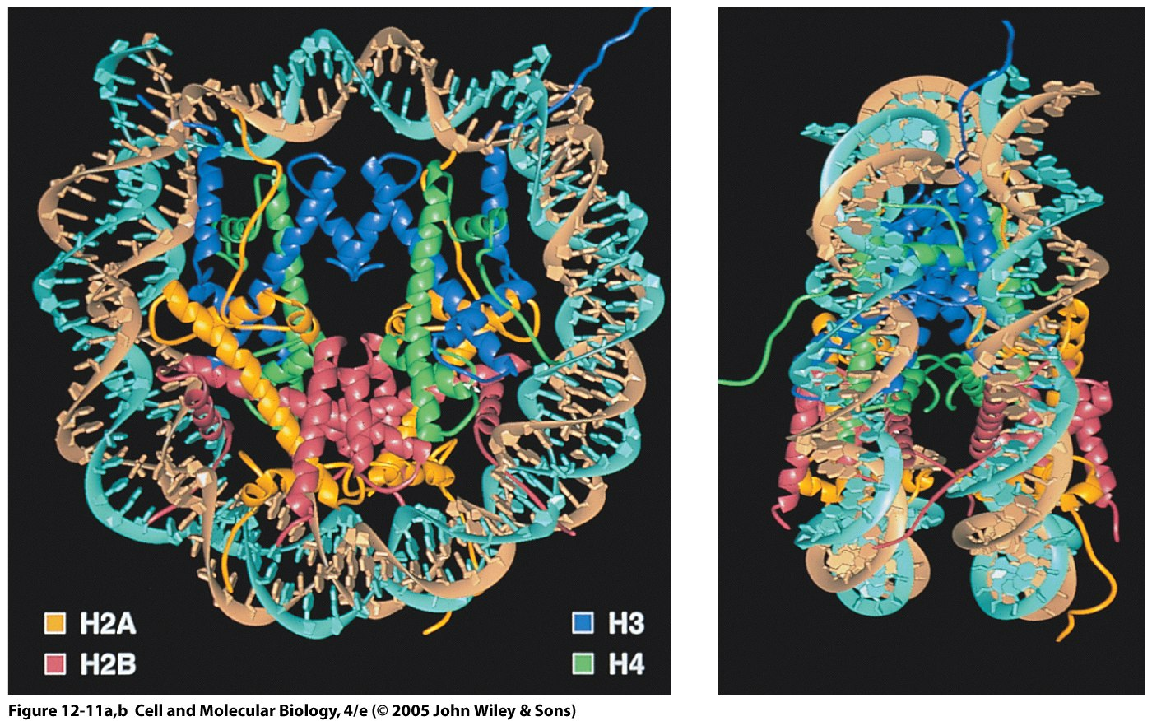
3D-Structure of Nucleosome

Slide 58
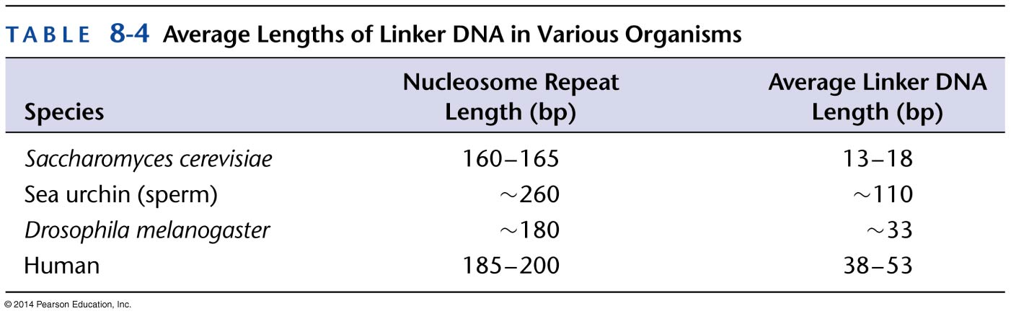

Slide 59
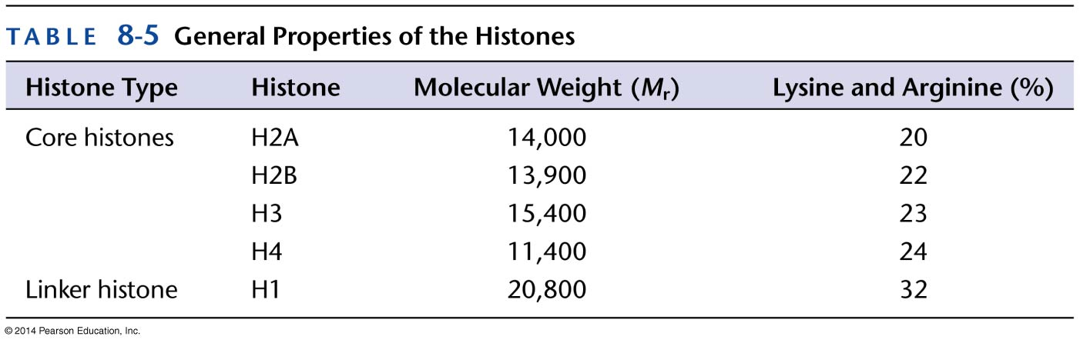
Histones
H2A, H2B, H3, H4: Equal amounts in cells
H1: Half the amount
At least 20% of the residues in histones are either lysine or arginine
Small in size: 11-15 kD (H1 is ~ 21kD)
The core is a disk-shaped structure that assembles in an ordered fashion only in the presence of DNA

Slide 60
A conserved region found in every histone, called histone-fold domain (3 α-helical regions), mediates the assembly of these histone-only intermediates
Mediates the formation of head-to-tail heterodimers of specific pairs of histones.
H3 and H4 first form heterodimers that then come together to form a tetramer with 2 molecules each of H3 and H4
In contrast, H2A and H2B form heterodimers and not tetramers
The assembly of a nucleosome involves the ordered association of these building blocks with DNA

Slide 61
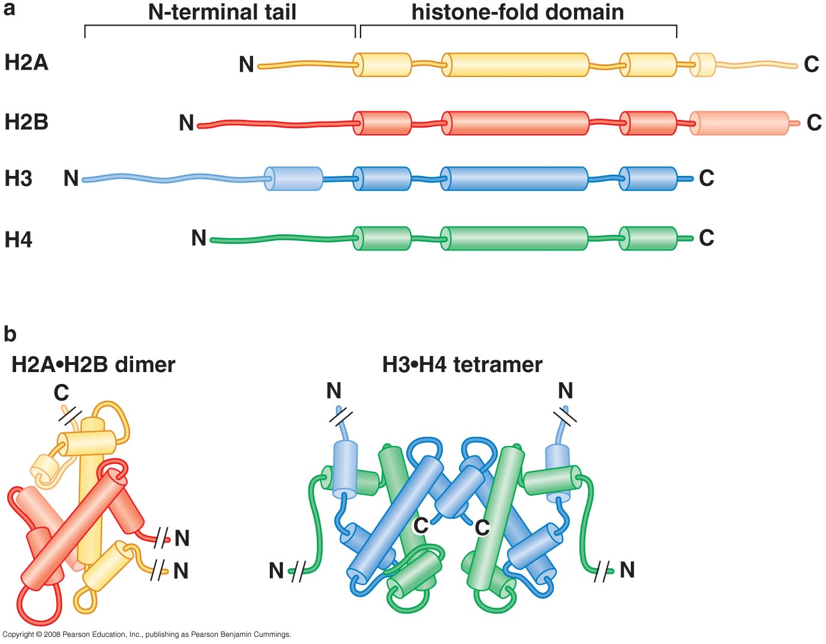
Core Histones
H1: linker histone is not
Part of the nucleosome

Slide 62
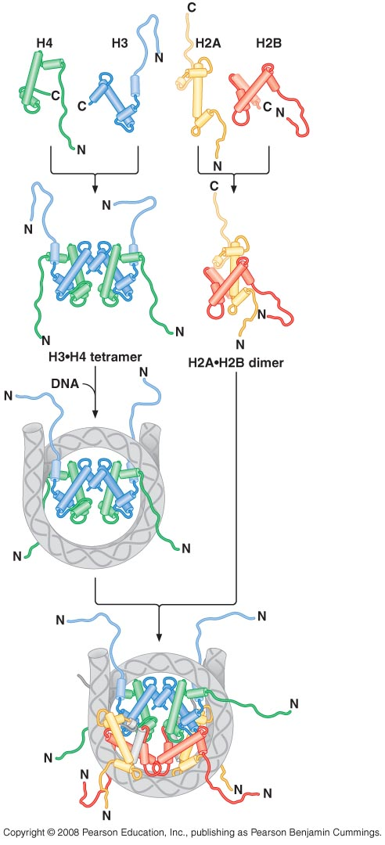
Assembly of nucleosome
STEP 1
H3 & H4 form a heterodimer
↓
heterotetramer

Slide 63
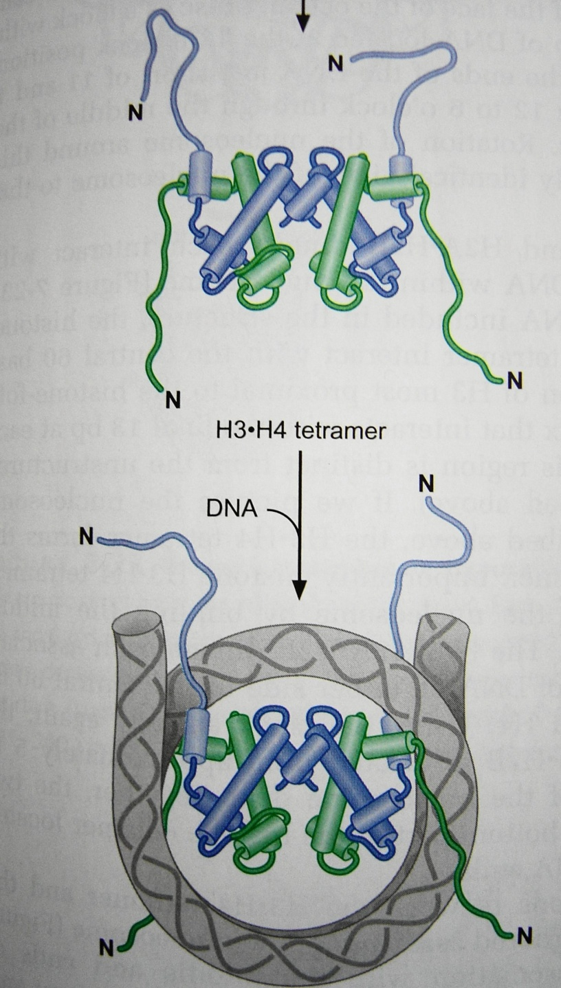
STEP 2
H3-H4 tetramer binds to DNA

Slide 64
STEP 3
The H3₂.H4₂ tetramer bound to DNA recruits two copies of H2A.H2B dimer to complete the assembly

Slide 65
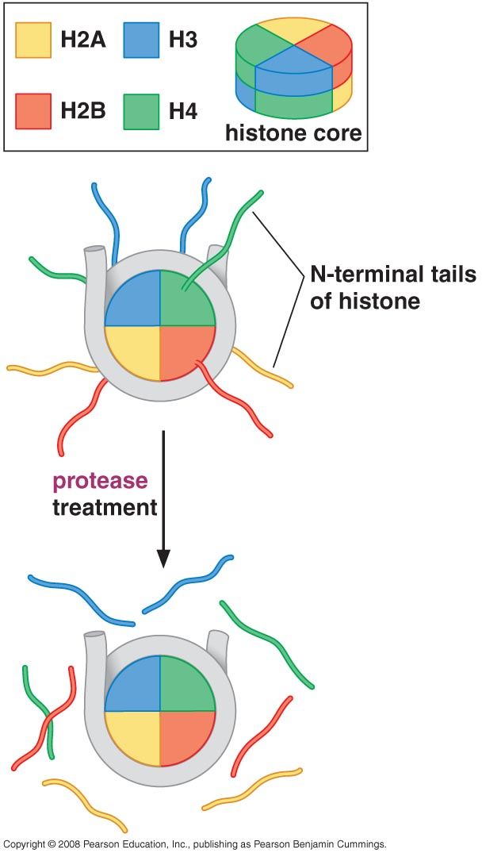
Amino terminal tails of the core histones are accessible to proteases
The core histones each have an amino terminal extension, called tail, it lacks a defined structure and is accessible within the intact nucleosome (detected by trypsin treatment)
Tails are sites of extensive modifications that alter the function of individual nucleosomes
Phosphorylation, acetylation and methylation on serine, lysine and arginine

Slide 66
What is the atomic structure of a nucleosome?
How does the structure enhance DNA –histone relationship?
How does it help biological functions?
Notes:
We will present each feature of the atomic structure of a nucleosome and will state how it enhance DNA –Histone relation ship and how if might affect the biological functions when ever applicable

Slide 67
Atomic structure of a nucleosome

Slide 68
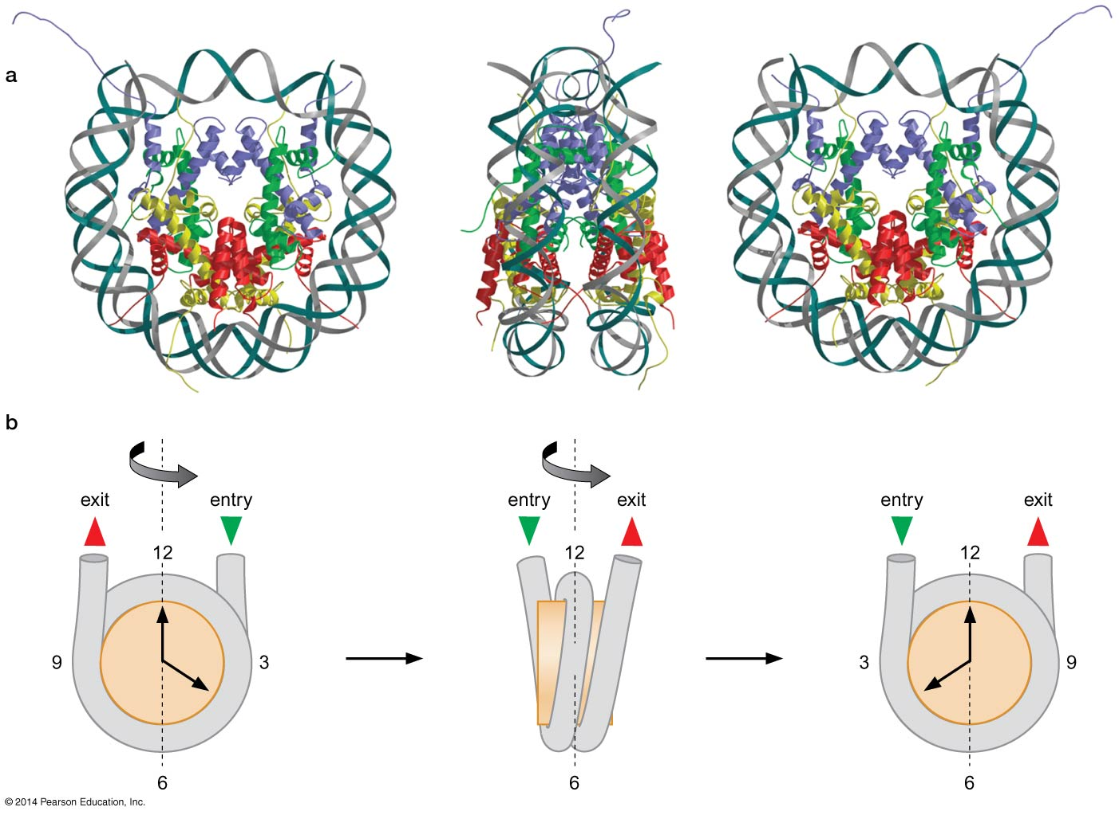
Dyad axis
Two fold symmetry axis

Slide 69

Long interaction between H3-H4 tetramer with DNA
H3.H4 tetramer interact with the central 60 bp
The amino-terminal region of H3 most proximal to the histone-fold region forms a 4th α-helix that interacts with the final 13 bp at each end of the bound DNA
H3.H4 forms the top half of the histone octamer

Slide 70

H2A.H2B dimers each associate with ~ 30 bp of DNA on either side of the central 60 bp of bound by H3 and H4.
The H2A,H2B dimers form the bottom part of the histone octamer

Slide 71

Nucleosome lacking H2A and H2B
Extensive interaction between the H3.H4 tetramer and the DNA help to explain the ordered assembly of the nucleosome
DNA extensively bent and constrained

Slide 72
DNA binds with the minor groove
14 distinct sites of contact are observed, one for each time the minor groove of the DNA faces the histone octamer
The association of DNA with the nucleosome is mediated by a large number (~40) H-bonds between histones and the DNA
The majority of these H-bonds are between the proteins and the oxygen atoms in the phosphodister backbone near the minor groove of the DNA
Only 7 H-bonds are made between the protein side chains and the bases and all are in the minor groove of the DNA
The large number of these H-bonds provides the driving force to bend the DNA

Slide 73
The highly basic nature of the histones further facilitates DNA bending by masking the –ve charge of the phosphates that usually resists DNA bending (when DNA is bent, the phosphates inside of the bend are brought into unfavorably close proximity
The finding that all of the sites of contact between the histones and the DNA involve either the minor groove or the phosphate backbone is consistent with the non-sequence specific nature of the association of the histone octamer with DNA

Slide 74

Sites of contact between the histones and the DNA

Slide 75
Histone tails interact with DNA
H3 &H2B pass between the two DNA helices through 2 adjacent minor grooves
H4 & H2A either above or below helices
↓
  Direct DNA to writhe around the histone octamer in a left handed manner
  Forms hydrogen bonds with DNA (the parts of the tails most proximal to the histone disc)

Slide 76

Histone tails emerge from the core of nucleosome at specific positions

Slide 77

DNA wrapping around histones stores negative superhelicity
Each nucleosome added to a cccDNA changes the linking number by ~ -1.2.
Because the remainder of the DNA is kept relaxed by topoisomerases, the DNA that is packaged into nucleosomes would become negatively supercoiled if nucleosomes were removed from the DNA (storing or stabilizing negative superhelicity →useful for initiation of replication, transcription, recombination because negatively super coiled DNA favors unwinding of DNA)

Slide 78


Slide 79



Slide 80
What serves the nucleosome function in prokaryotes?
For many bacteria the entire genome is maintained in a negatively supercoiled state (accomplished by DNA gyrase which requires ATP (with no ATP, it can only relax the DNA) e.g. E.coli has -0.07 super helical density
Thermophilic bacteria have a reverse gyrase which increases the linking number of relaxed DNA in the presence of ATP
By keeping the genome +vely supercoiled , it counteracts the effect of thermal denaturation that would ordinarily results in many region of the genome being unwound

Slide 81
Heterochromatin and Euchromatin
Heterochromatin: dense staining, condensed, limited gene expression, associated with telomeres and centromeres
Euchromatin: poorly stained , relatively open, high gene expression
Difference in nucleosome assembly
High ordered structures that results in a barrier to gene expression
Euchromatic nucleosomes are found in much less organized assemblies

Slide 82

10-nm fibre (beads on a string)

Slide 83

Higher – order chromatin structure
H1 is positively charged protein
It interacts with linker DNA (linker histone), protects DNA from nuclease digestion
H1 binds two distinct regions of the DNA molecule associated with a nucleosome
It increases the length of the DNA wrapped tightly around the histone octamer

Slide 84

Histone H1 tighter DNA wrapping around the nucleosome

Slide 85


Addition of H1 leads to more compact nucleosomal DNA
- H1 (10 nm)
+ H1 (30 nm)

Slide 86

The 30-nm fiber
H1, high salt form 30-nm fiber in a test tube
Solenoid model: ~ 6 nucleosomes per turn
Linker DNA is buried in the center of the superhelix and never passes through the axis

Slide 87

Zigzag model
The linker DNA pass through the central axis of the fiber in a relatively straight form
Thus, longer linker favors this conofrmation

Slide 88

N-terminal tails are also required for 30-nm fiber formation
Core histones lacking their tails are incapable of forming 30-nm fibers
They stabilize the fiber by interacting with adjacent nucleosomes
Speculative model for the stabilization
of the 30-nm fiber by histone amino-terminal tails

Slide 89

Higher-order structure
30-nm fiber compact DNA 40- fold only
Additional folding is required but the exact structure is unclear
One popular model proposes that the 30-nm fibers forms loops of 40-90 kb that are held together at their bases by a proteinaceous structure referred to as the nuclear scaffold
Two classes of proteins have been identified:
  Topisomerase II: ensure that the loops are topologically isolated from one another
  SMC protein: may enhance their function in condensing and holding sister chromatids together

Slide 90


Higher-order structure of chromatin

Slide 91


Higher chromatin structure

Slide 92

Figure 16.22a
Nucleosome
(10 nm in diameter)
DNA double helix
(2 nm in diameter)
H1
Histone
tail
Histones
Nucleosomes, or “beads on
a string” (10-nm fiber)
DNA, the double helix
Histones
Notes:
Figure 16.22 Exploring: Chromatin Packing in a Eukaryotic Chromosome

Slide 93

Figure 16.22b
Chromatid
(700 nm)
30-nm fiber
Loops
Scaffold
300-nm fiber
30-nm fiber
Replicated
chromosome
(1,400 nm)
Looped domains
(300-nm fiber)
Metaphase
chromosome
Notes:
Figure 16.22 Exploring: Chromatin Packing in a Eukaryotic Chromosome

Slide 94

Chromosome

Slide 95
Histone Variants
Histones are the most conserved proteins
Histone variant replace one of the histone proteins:
  Conduct specific function
  Certain region of the chromosome

Slide 96

Examples of Histone Variants
H2A.X replace H2A at different sites of eukaryotic DNA
H2A.X located adjacent to the break is phosphorylated →recognized by DNA repair enzymes
CENP-A replaces H3 at centromeric DNA
CENP-A includes extended amino-terminal region which generates novel binding sites or other protein components of the kinetochore

Slide 97
A Paradox
The nucleosome perform two opposite functions simultaneously:
Nucleosomes help to compact DNA which aids its protection.
Nucleosomes must allow access to the information in the DNA.
  DNA Polymerases must gain access to replicate the DNA when the cell divides.
  RNA Polymerase must transcribe messenger RNA

Slide 98
How can the nucleosome provide access to DNA?

Slide 99

Interaction of DNA with Histone Octamer
Association of histone octamer with the DNA is dynamic (not permanent)
Important→ many DNA-binding proteins strongly prefer to bind free DNA
Unwrapping of the DNA from nucleosome is responsible for accessibility of the DNA
DNA sites closest to the entry and exit points are the most accessible and sites closest to the midpoint of the bound DNA are least accessible

Slide 100

Nucleosome remodeling complexes
The multiprotein complexes uses ATP to facilitate changes in nucleosome location or interaction with the DNA
2 Types of movement:
  Sliding: movement along DNA molecule
  Transfer: from one helix to another

Slide 101

Suggested model for nucleosome remodeling complex action

Slide 102

Figure 8-36a
Notes:
Figure 8-36a

Slide 103

Figure 8-36b
Notes:
Figure 8-36b

Slide 104

Figure 8-36c
Notes:
Figure 8-36c

Slide 105

Figure 8-36d
Notes:
Figure 8-36d

Slide 106

Figure 8-36e
Notes:
Figure 8-36e

Slide 107

Nucleosome remodeling complexes

Slide 108
Nucleosome positioning
Definition
To restrict the nucleosome at certain positions to allow accessibility of DNA to regulatory proteins.
Allows the DNA-binding site for regulatory protein to remain in the accessible linker DNA region

Slide 109
What determine the position of nucleosome?
Presence of transcription factors
Particular DNA sequence
Modifications of the N-terminal tails

Slide 110


Presence of transcription factors
  If two proteins are bound to sites closer than <150 bp → nucleosome free
  Some DNA-binding proteins interact tightly with adjacent nucleosomes, leading to nucleosomes preferentially assembling immediately adjacent to these proteins

Slide 111

2. Particular DNA sequence that have a high affinity to nucleosomes
  Nucleosomes preferentially form on DNA that bends easily (A:T rich regions which tends to bend towards the minor groove that faces histone octamer)
  Not required for histone assembly
  Tightly positioned nucleosomes are found at sites that directing the initiation of transcription

Slide 112
3. Modification of N-Terminal Tail
Acetylation
Methylation
Phosphorylation
Lys amino acid
Ser amino acid

Slide 113

Figure 8-40
Notes:
Figure 8-40
©2011 Elsevier http://www.sciencedirect.com/science/article/pii/S0968089611000757

Slide 114

Modifications of the histone amino-terminal tails alters the function of chromatin

Slide 115
  Modification of histone tails forms a histone code that can be read by proteins involved in gene expression and other DNA transactions
  The type of modification and the site modified are important for understanding this code

Slide 116
Effect of N-Terminal Tail Modification
Act as a code for proteins involved in gene expression
Affecting nucleosome itself
  Ac reduces the +ve charge of histone tail → reduce binding to DNA
  Reduces the ability to form more repressive 30-nm fiber
Generate binding sites for specific proteins

Slide 117

Act as a code for proteins involved in gene expression

Slide 118
Nucleosome Remodeling domains
  Bromodomain: is an approximately 110 amino acid protein domain that recognizes acetylated lysine residues, such as those on the N-terminal tails of histones. → Acetylation
  Chromodomain: is a protein structural domain of about 40-50 amino acid residues commonly found in proteins associated with the remodeling and manipulation of chromatin. → Methylation
  TUDOR domains: is a conserved protein structural motif originally identified as a region of 50 amino acids found in the Tudor protein encoded in Drosophila. → Methylation
  PHD fingers: The PHD finger was discovered in 1993 as a Cys₄-His-Cys₃ motif in the plant homeodomain (hence PHD) proteins. Approximately 50-80 amino acids in length, and are involved in chromatin-mediated gene regulation.→ Methylation
  SANT domain :is a protein domain that allows many chromatin remodeling proteins to interact with histones; recent studies have indicated that the SANT domain has a central role in chromatin remodeling by functioning as a unique histone-interaction module that couples histone binding to enzyme catalysis. → unmodified histone

Slide 119
How do the domains that recognize modified histones alter the function of the associated nucleosomes?
Modified histones recruit enzymes that will further modify adjacent nucleosomes
e.g. histone acetyltransferases include bromodomains that recognize the same histone modifications they create
They can also recruit other proteins that act on chromatin e.g. TFIID has a bromodomain that directs the transcription machinery to sites of nucleosome acetylation

Slide 120


Slide 121

Free access to DNA is determined by:
N-terminal modification
Nucleosome remodeling complexes
Nucleosome positioning

Slide 122

Nucleosome Assembly

Slide 123

Normal
Mutant
Normal:
GAGCAGGTC GAAGGGGATGGCGGCCACCATGTCGAT GAG GAA CCA GCC
Mutant:
T GAG CAG GTC GAG GAA CCA GCC
Deleted sequence:
GAA GGG GAT GGC GGC CAC CAT GTC GAT

Slide 124

Chaperones: a group of proteins that bind histones and regulate nucleosome assembly such as Nap-1 (act as histone reservoirs and regulate histone supply).

Slide 125


Slide 126
END

